Slide 1
COMPUTER ORGANIZATION AND ARCHITECTURE
UNIT 4: MEMORY UNIT

Slide 2
MEMORY
Memory is the computer's electronic scratchpad or local store in computer terminology.
Used for temporary storage of calculations, data, and other work in progress.
Two types: Primary and Secondary
Primary memory or the main memory is part of the main computer system. The primary memory itself is of two types.
The first is called random access memory (RAM) and the other is read only memory (ROM).

Slide 3
Some reasons why memory play vital role in computers overall performance.
Storage of Data: Allows the access of data quickly
Multitasking: multiple tasks simultaneously
Running Application: Applications require some memory to run
Operating System: Also requires to run smoothly.

Slide 4
IMPORTANCE OF MEMORY:
Speed
Capacity
Stability
Cost
Scalability

Slide 5
Sample Configuration: 1TB, 16 GB, 768 KB, 4 MB, 16 MB

Slide 6
VARIETIES OF SEMICONDUCTOR RANDOM ACCESS MEMORIES
Main memory of computers
Read Only Memory (ROM)
Read/Write memory
Factory Programmed
User Programmable PROM
Erasable PROM
SRAM
DRAM
Permanent non-erasable
(Non-erasable)
UVEPROM
EEPROM

Slide 7
RANDOM ACCESS MEMORY (RAM)
The processor directly stores and retrieves information from it.
Memory is organized into locations. Each memory location is identified by a unique address. The access time is same for all location.
It is volatile: when turned off, everything in RAM disappears.
Two types:

Slide 8
TYPES OF RAM
Dynamic Random Access Memory (DRAM):
This type RAM retain the content of any location only for a few milliseconds. Within that period, each location must be written again with the same contents. This is known as refreshing.
Static Random Access Memory (SRAM):
This type of RAM preserves the contents of all the locations as long as the power supply is present. SRAM is generally included in a computer system by the name of cache.

Slide 9
SEMICONDUCTOR RAM
It allows data to be read and written in almost the same amount of time irrespective of the physical location of data inside the memory. It uses semiconductor technology to store the data.

Slide 10
Feature | DRAM | SRAM
Storage | Uses Capacitors | Uses bistable latches (Flipflops)
Speed | Slower | Faster
Refresh | Required | Not Required
Power | Lower power consumption | Higher power consumption
Cost | Cheaper | More expensive
Usage | Main System M/Y | Cache M/Y

Slide 11
READ ONLY MEMORY (ROM)
Data stored in ROM cannot be modified, or can be modified only slowly or with difficulty, so it is mainly used to distribute.
The instructions in ROM are built into the electronic circuits of the chip which is called firmware.
Random access in nature and non-volatile.

Slide 12
TYPES OF ROM
Programmable read-only memory (PROM), or one-time programmable ROM can be written to or programmed via a special device called a PROM programmer.
Erasable programmable read-only memory (EPROM) can be erased by exposure to strong ultraviolet light then rewritten with a process that again needs higher than usual voltage applied.
Electrically erasable programmable read-only memory (EEPROM) is based on a similar semiconductor structure to EPROM, but allows its entire contents (or selected banks) to be electrically erased, then rewritten electrically, so that they need not be removed from the computer

Slide 13
FLASH MEMORY
Modern type of EEPROM invented in 1984.
Faster than regular EEPROM
Use one transistor per memory cell and come in different capacities
The read time is much smaller (tens of nanoseconds) compared write time (tens of microseconds).
Commonly used for USB drives, SSDs.

Slide 14
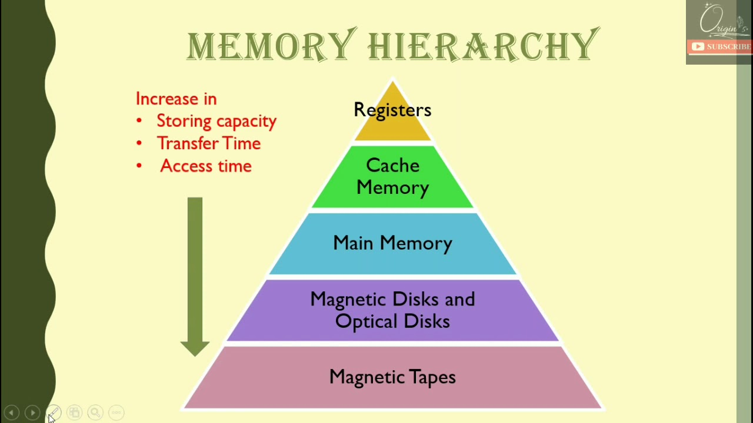

Slide 15
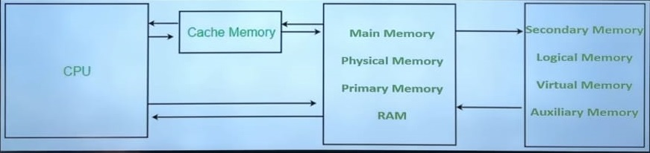

Slide 16
HOW CPU USES M/Y HIERARCHY
Cache memory boosts processing speed. It bridges the speed gap between the processor and main memory.
Main m/y holds data for immediate access by the CPU.
For efficient processing, data sought by the CPU should ideally be in Cache.
Sample Configuration: 1TB, 16 GB, 768 KB, 4 MB, 16 MB

Slide 17
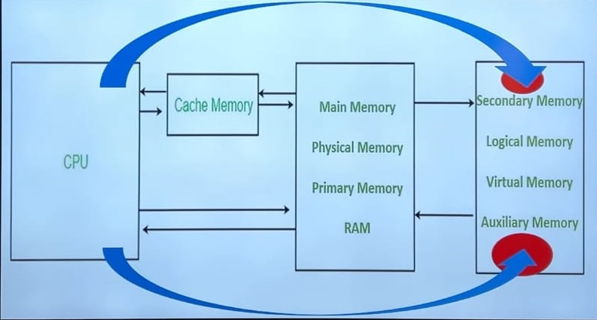
LOCALITY OF REFERENCE
It refers to the tendency of a program to access a small portion of its memory at a given time. While the majority of the m/y is unused. There are two types of locality of reference: temporal and spatial locality.

Slide 18
SPATIAL AND TEMPORAL LOCALITY
Spatial locality Refers to the tendency of a program to access m/y locations that are close to each other. This means that if a program accesses a m/y location, it is likely to access other nearby m/y locations soon after.
Temporal refers to the tendency of a program to access recently used m/y locations repeatedly. This means that if a program accesses a m/y location, it is likely to access that same location again in the near future.

Slide 19
Cache Hit:
Cache Miss:
Hit Ratio:
Hit Latency:
Cache Miss:
Miss Latency:

Slide 20
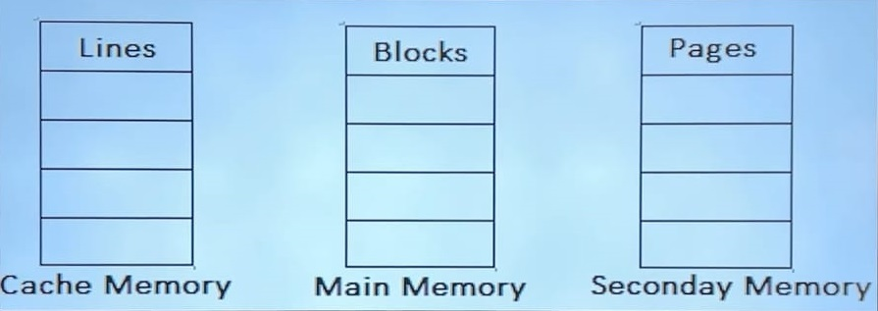

Slide 21
10^3 | 1 Kilo
10^6 | 1 Mega
10^9 | 1 Giga
10^12 | 1 Tera
10^15 | 1 Peta
2^10 | 1 Kilo
2^20 | 1 Mega
2^30 | 1 Giga
2^40 | 1 Tera
2^50 | 1 Peta
Address Length in bits: n
Number of Locations: 2^n
Locations: Upper bound(Log₂n)
Number of bits: n

Slide 22
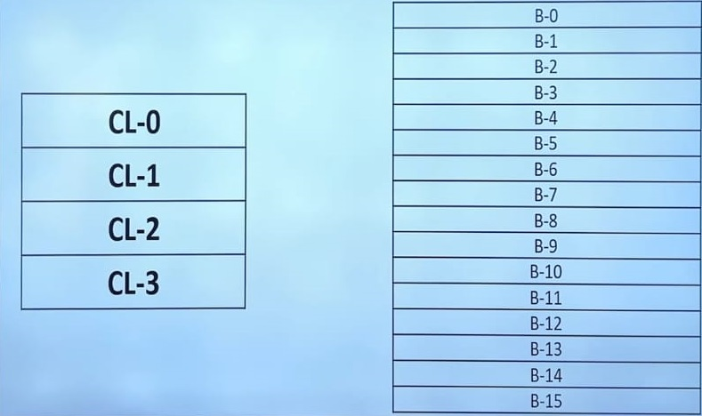

Slide 23
CACHE MAPPING ALGORITHMS
Cache mapping refers to the process of determining where data should be stored in the cache memory.
The cache mapping algorithms determines which cache lines are assigned to which main memory blocks

Slide 24
ALGORITHMS:
There are several ways including:
Direct Mapping
Associative mapping
Set-associative mapping

Slide 25
DIRECT MAPPING:

Slide 26
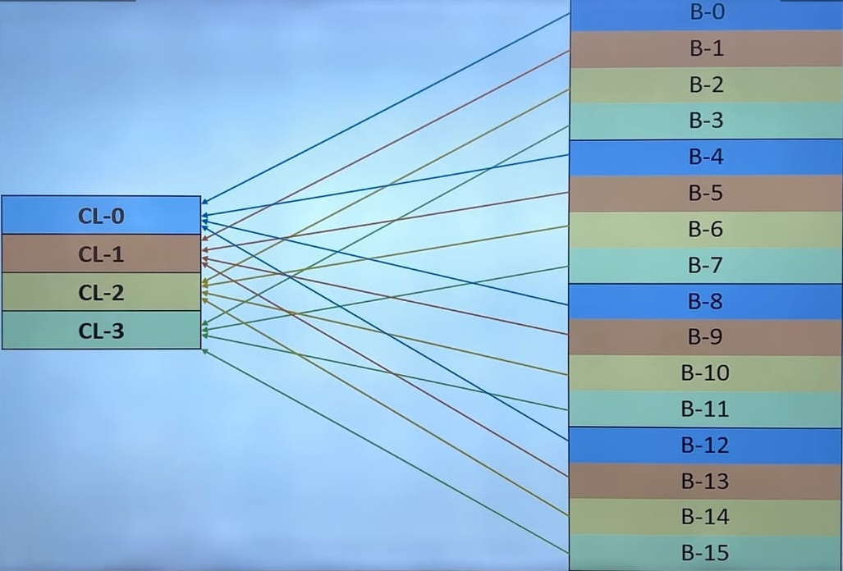

Slide 27
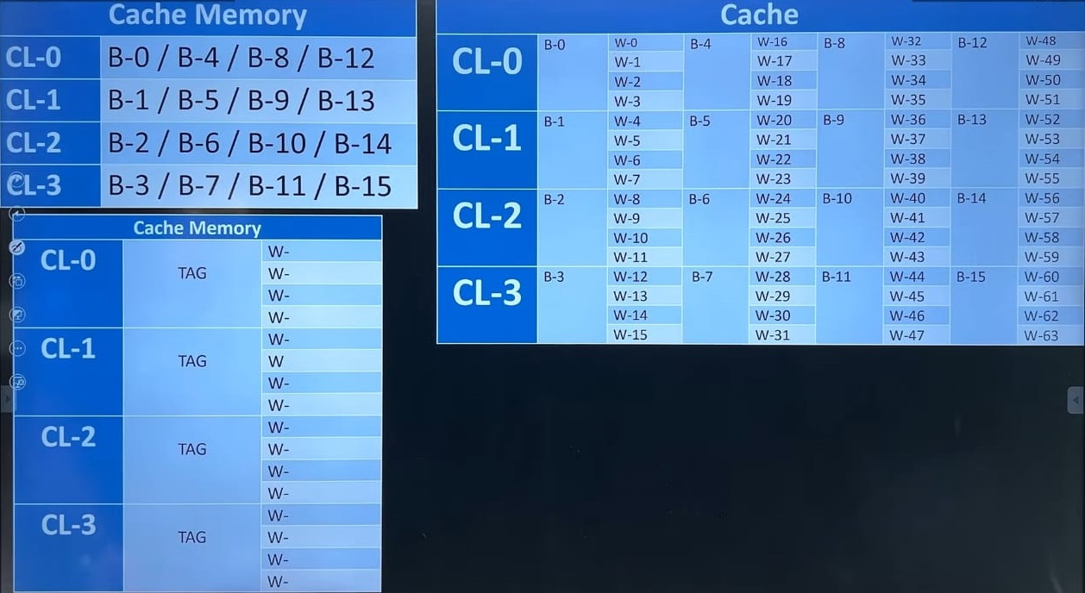

Slide 28
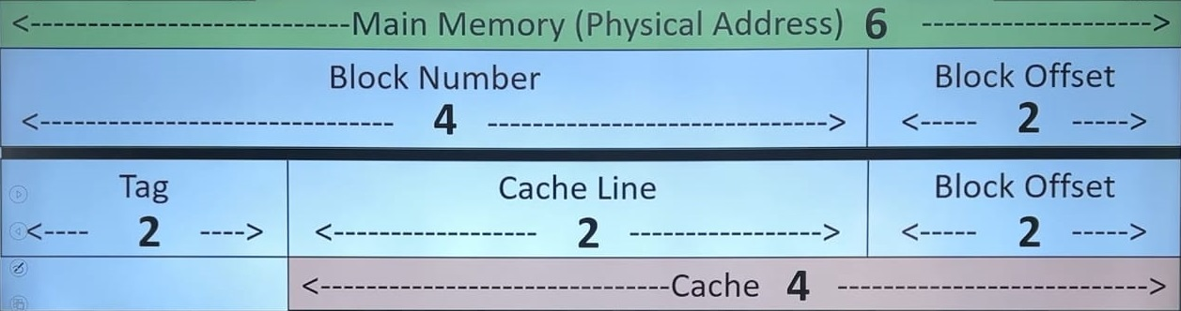

Slide 29
The main advantage of direct mapping is its simplicity. Since each main m/y block maps to only one specific cache line there is no need for complicated search algorithms. This makes direct mapping relatively fast and efficient.

Slide 30
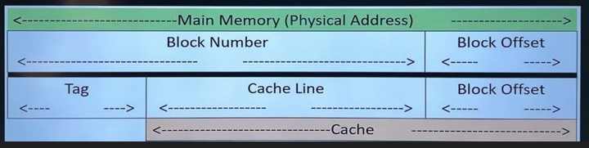
MM Size | Cache Size | Block Size | No. of Bits in Tag | Tag Directory Size
16 GB | 32 MB | 4 KB | — | 2^13*9
32 GB | 64 MB | 512 KB | — | —
32 GB | 128 MB | 1 KB | — | —
256 MB | 16 KB | 1 KB | — | —
4 GB | 8 MB | 2 KB | — | —
512 KB | 2 KB | 128 B | — | —

Slide 32
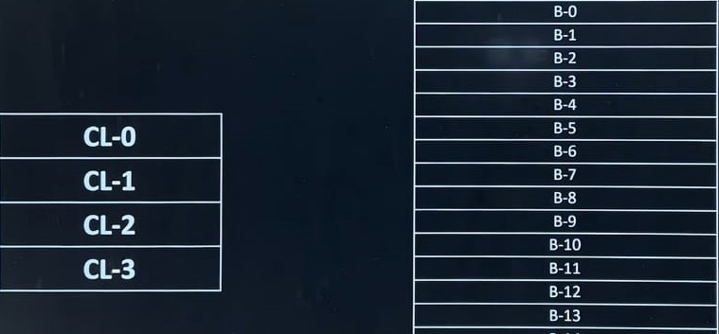
ASSOCIATIVE MAPPING
Resolution of the problem of conflict miss.
Block memory can be mapped to any freely available cache line.
Fully Associative is more flexible than direct mapping
Also known as many to many mapping.
Conflict miss doesn’t occur while capacity miss may occur.

Slide 33
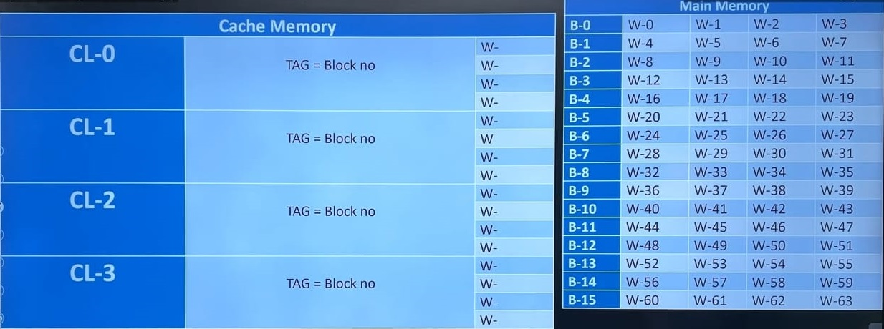

Slide 34
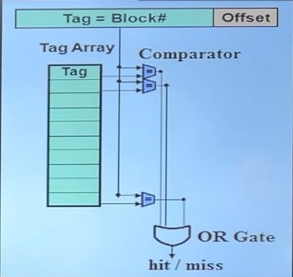

Slide 35
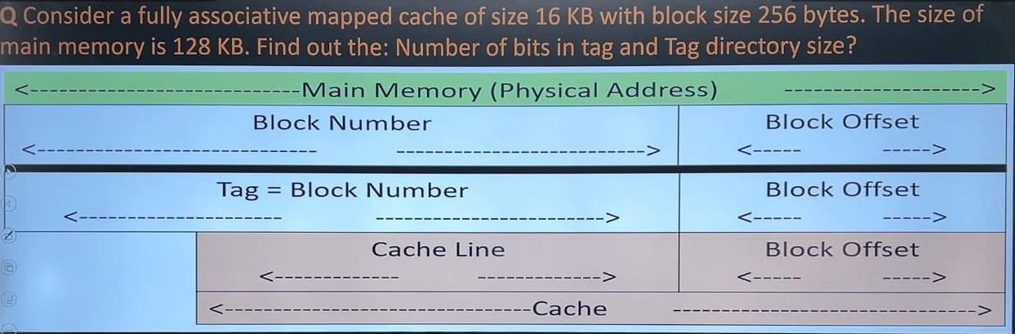

Slide 36
DISADVANTAGE
Hardware cost is high
Tag directory size is more as compared to direct mapping.

Slide 37
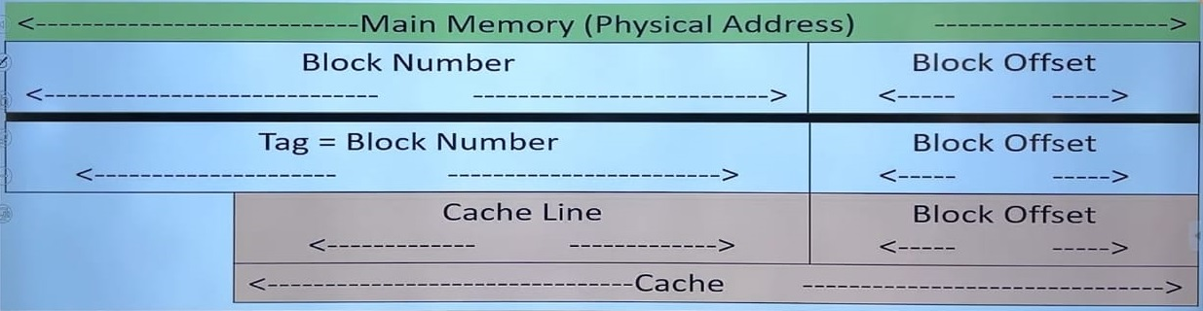

Slide 38
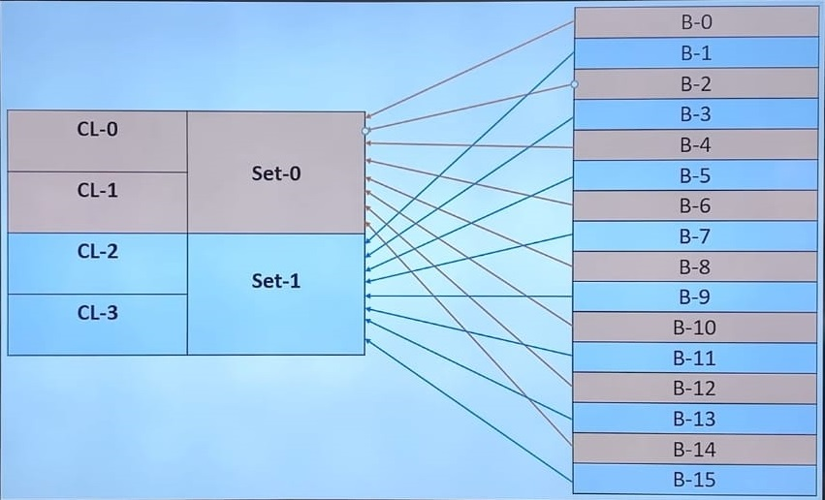
SET-ASSOCIATIVE MAPPING
Stage 1: Fixed for sets (Direct Mapping)
Stage 2: flexible (Associative Mapping)

Slide 39
SET-ASSOCIATIVE MAPPING
In K-way set associative mapping, cache lines are grouped into sets where each set contains K number of lines
A particular block of main m/y can map to only one particular set of cache
However, within a set, the m/y block can map to any freely available cache line.

Slide 40
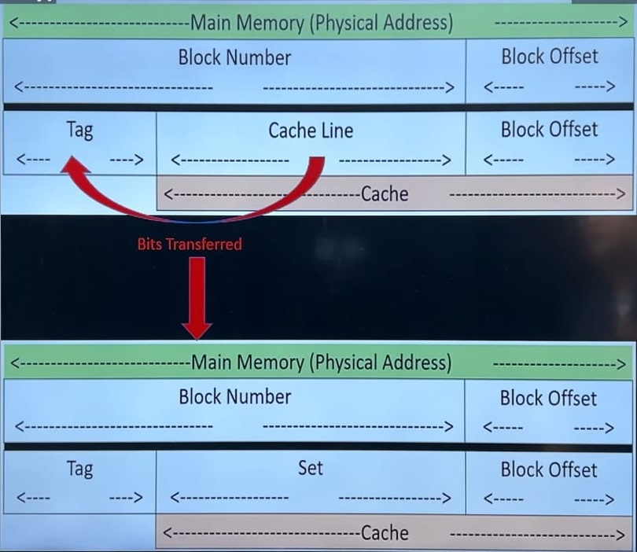

Slide 41
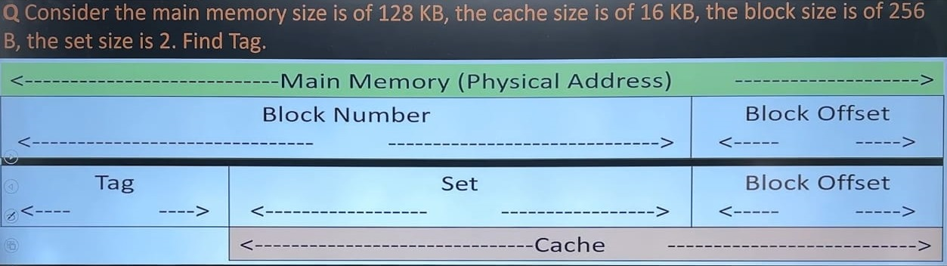

Slide 42
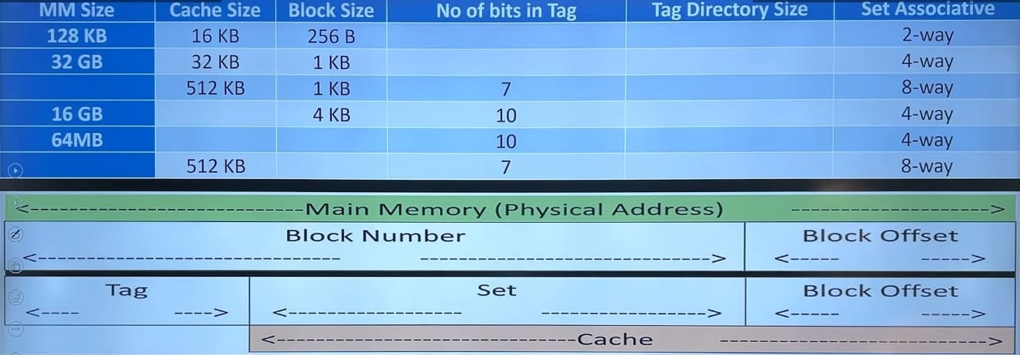

Slide 43
CACHE REPLACEMENT POLICIES
FIFO
Optimal
LRU
MRU
Note: In direct mapping no replacement policy exists.

Slide 44
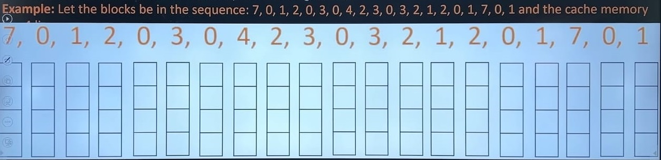

Slide 45
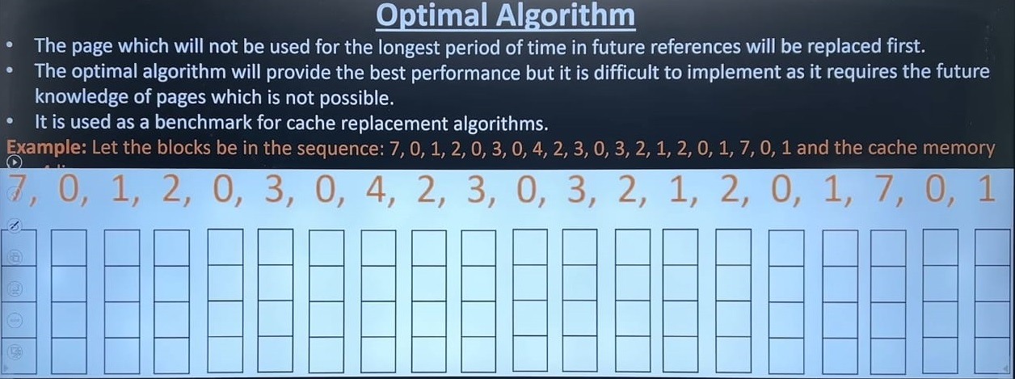

Slide 46
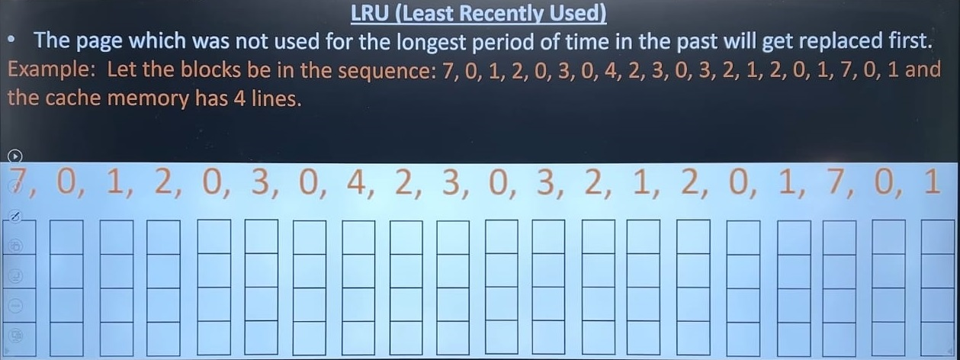

Slide 47
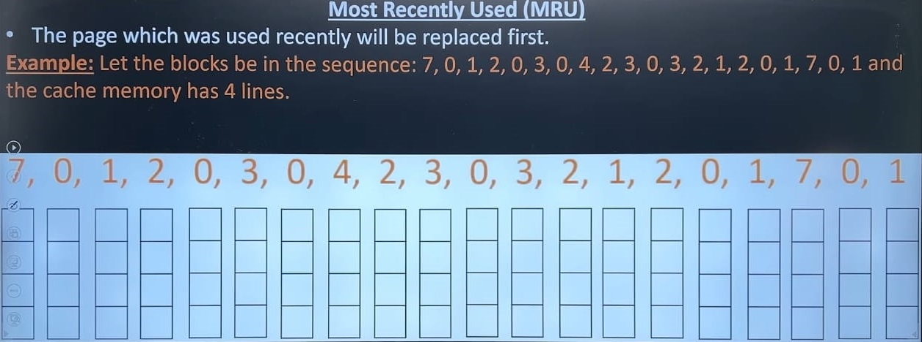

Slide 48
TYPES OF MISS:
Compulsory Miss: CPU demands a block for the first time.
Conflict Miss: When several blocks are mapped to same set.
Capacity Miss: No available space is in cache.

Slide 49
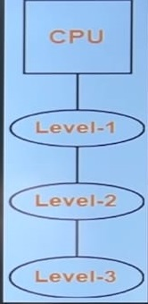
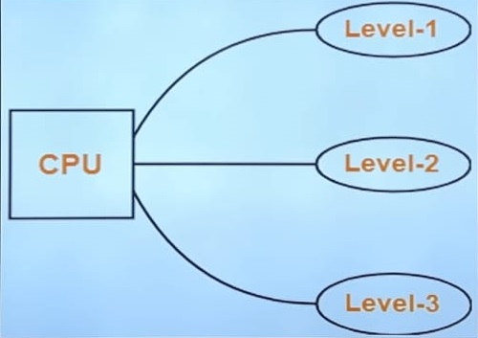
MEMORY ORGANIZATION
Simultaneous Access
Hierarchical Access

Slide 51
CACHE COHERENCE PROBLEM
If multiple copy of same data is maintained at different level of memories, then inconsistency may occur, this problem is known as cache coherence problem.
Solution: Write through and Write back

